Slide 1


.Netframe work
.NET Framework is a software development framework for building and running applications on Windows.
.NET Framework is part of the .NET platform, a collection of technologies for building apps for Linux, macOS, Windows, iOS, Android, and more.

Slide 2
.NET and .NET Framework
.NET is a developer platform made up of tools, programming languages, and libraries for building many different types of applications.
There are various implementations of .NET. Each implementation allows .NET code to execute in different places—Linux, macOS, Windows, iOS, Android, and many more.
.NET Framework is the original implementation of .NET. It supports running websites, services, desktop apps, and more on Windows.
.NET is a cross-platform implementation for running websites, services, and console apps on Windows, Linux, and macOS. .NET is open source on GitHub. .NET was previously called .NET Core.
Xamarin/Mono is a .NET implementation for running apps on all the major mobile operating systems, including iOS and Android.

Slide 3

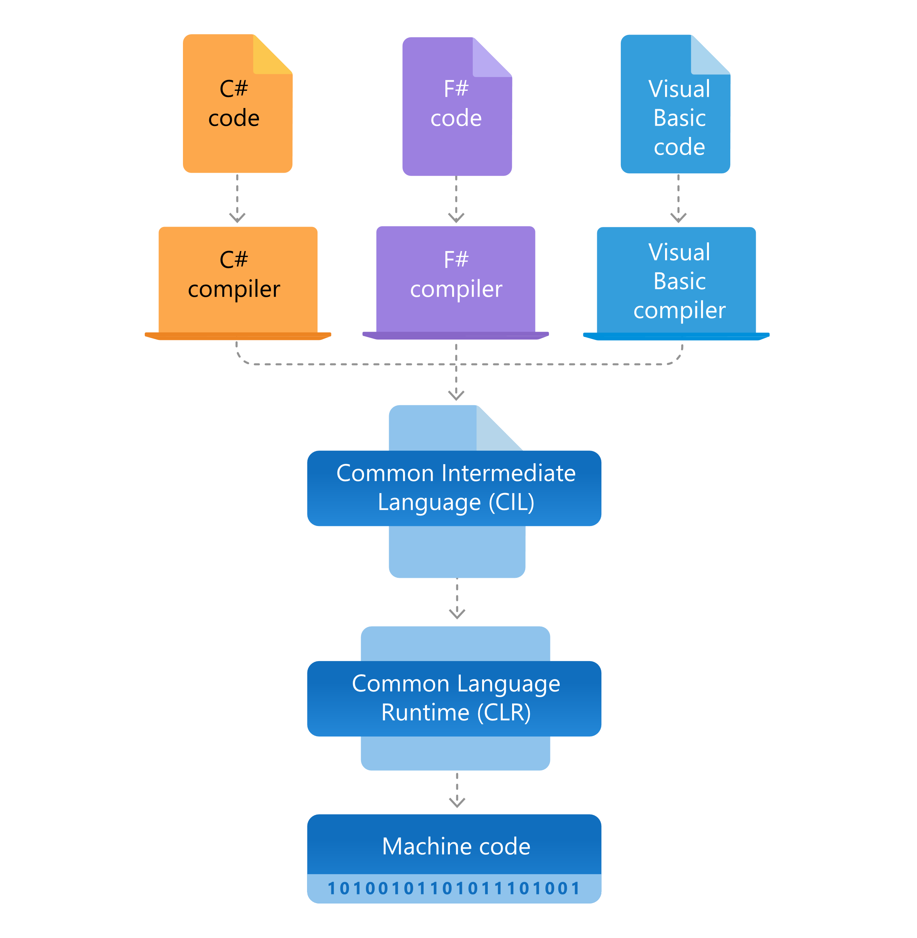



Architecture of .NET Framework

Slide 4
The two major components of .NET Framework are the Common Language Runtime and the .NET Framework Class Library.
The Common Language Runtime (CLR) is the execution engine that handles running applications. It provides services like thread management, garbage collection, type-safety, exception handling, and more.
The Class Library provides a set of APIs and types for common functionality. It provides types for strings, dates, numbers, etc. The Class Library includes APIs for reading and writing files, connecting to databases, drawing, and more.
.NET applications are written in the C#, F#, or Visual Basic programming language. Code is compiled into a language-agnostic Common Intermediate Language (CIL). Compiled code is stored in assemblies—files with a .dll or .exe file extension.

Slide 5
NET Framework for users
If you don't develop .NET Framework apps, but you use them, you aren't required to have specific knowledge about .NET Framework or its operation. For the most part, the framework is completely transparent to users.
If you're using the Windows operating system, .NET Framework may already be installed on your computer. In addition, if you install an app that requires .NET Framework, the app's setup program might install a specific version of the framework on your computer. In some cases, you may see a dialog box that asks you to install .NET Framework. If you've just tried to run an app when this dialog box appears and if your computer has internet access, you can go to a webpage that lets you install the missing version of .NET Framework.

Slide 6
NET Framework for developers
If you're a developer, choose any programming language that supports .NET Framework to create your apps. Because .NET Framework provides language independence and interoperability, you interact with other .NET Framework apps and components regardless of the language with which they were developed.

Slide 7
The following releases have reached end of life, meaning they're no longer supported.
Version | Release date | End of support
.NET Framework 4.5.1 | October 17, 2013 | January 12, 2016
.NET Framework 4.5 | August 15, 2012 | January 12, 2016
.NET Framework 4.0 | April 12, 2010 | January 12, 2016

Slide 8
The following are the supported version of .net framework
Versions of .NET Framework available for download
Version | Release date | End of support
.NET Framework 4.8 (recommended) | April 18, 2019
.NET Framework 4.7.2 | April 30, 2018
.NET Framework 4.7.1 | October 17, 2017
.NET Framework 4.7 | April 5, 2017
.NET Framework 4.6.2 | August 2, 2016
.NET Framework 4.6.1 | November 30, 2015 | April 26, 2022
.NET Framework 4.6 | July 20, 2015 | April 26, 2022
.NET Framework 4.5.2 | May 5, 2014 | April 26, 2022
.NET Framework 3.5 SP1 | November 18, 2008 | October 10, 2028

Slide 9
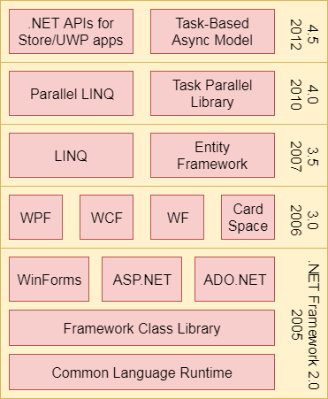
The .NET Framework is composed of four main components:
Common Language Runtime (CLR)
Framework Class Library (FCL),
Core Languages (WinForms, ASP.NET, and ADO.NET), and
Other Modules (WCF, WPF, WF, Card Space, LINQ, Entity Framework, Parallel LINQ, Task Parallel Library, etc.)

Slide 10
CLR (Common Language Runtime)
It is a program execution engine that loads and executes the program. It converts the program into native code. It acts as an interface between the framework and operating system. It does exception handling, memory management, and garbage collection.
FCL (Framework Class Library)
It is a standard library that is a collection of thousands of classes and used to build an application. The BCL (Base Class Library) is the core of the FCL and provides basic functionalities.
WinForms
Windows Forms is a smart client technology for the .NET Framework, a set of managed libraries that simplify common application tasks such as reading and writing to the file system.

Slide 11
ASP.NET
ASP.NET is a web framework designed and developed by Microsoft. It is used to develop websites, web applications, and web services. It provides a fantastic integration of HTML, CSS, and JavaScript. It was first released in January 2002.
ADO.NET
ADO.NET is a module of .Net Framework, which is used to establish a connection between application and data sources. Data sources can be such as SQL Server and XML. ADO .NET consists of classes that can be used to connect, retrieve, insert, and delete data.
WCF (Windows Communication Foundation)
It is a framework for building service-oriented applications. Using WCF, you can send data as asynchronous messages from one service endpoint to another

Slide 12
LINQ (Language Integrated Query)
It is a query language, introduced in .NET 3.5 framework. It is used to make the query for data sources with C# or Visual Basics programming languages.
Entity Framework
It is an ORM based open source framework which is used to work with a database using .NET objects. It eliminates a lot of developers effort to handle the database. It is Microsoft's recommended technology to deal with the database.
Parallel LINQ
Parallel LINQ or PLINQ is a parallel implementation of LINQ to objects. It combines the simplicity and readability of LINQ and provides the power of parallel programming.
It can improve and provide fast speed to execute the LINQ query by using all available computer capabilities.

Slide 13

Thank you

